Slide 1
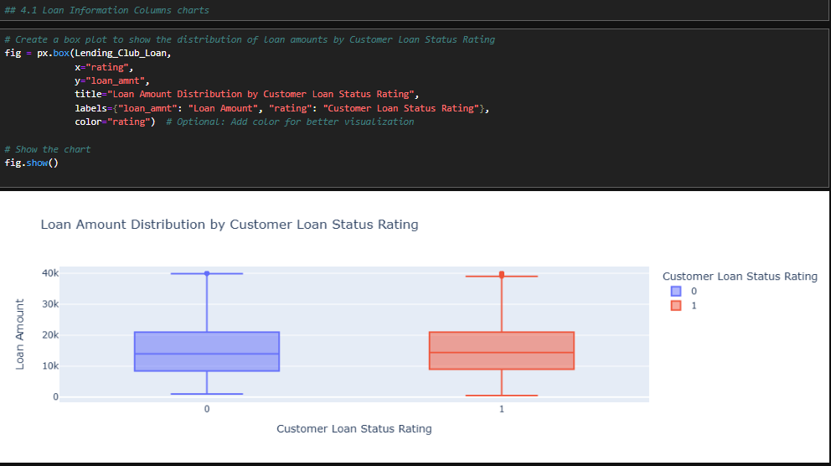
Data visualization
Loan Information Columns charts
Visualizing the distribution of "Loan Amount" against "Customer Loan Status Rating," where 0 and 1 represent different customer ratings. The plot highlights that loan amounts for both ratings are centered around similar medians but show differences in their spread and outliers.

Slide 2
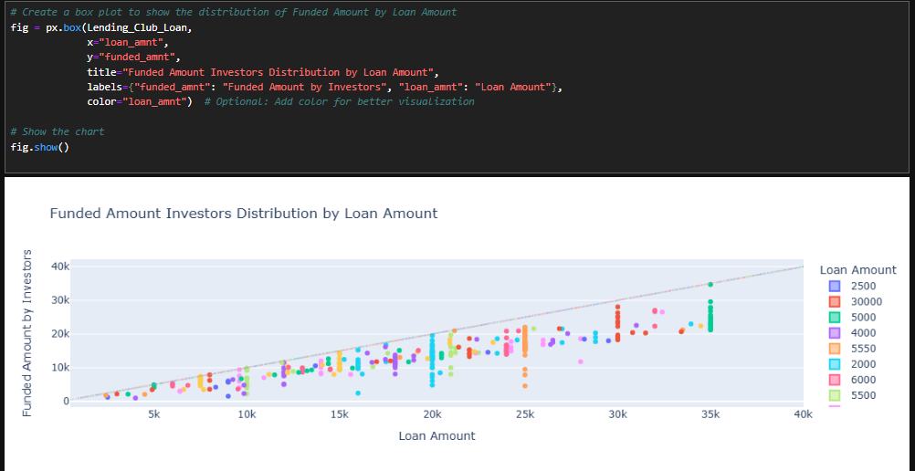
The distribution of "Funded Amount by Investors" against "Loan Amount," showing how funded amounts vary across different loan sizes. It likely highlights the central tendency, spread, and any potential outliers, indicating whether funded amounts are closely aligned or vary significantly with loan amounts.

Slide 3
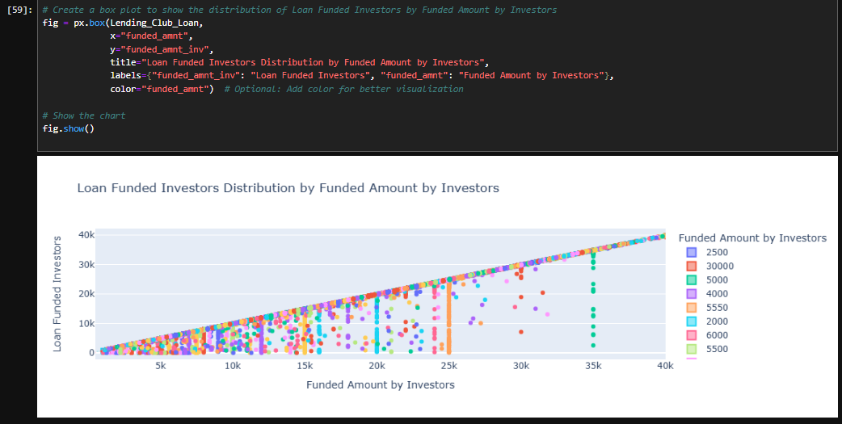
The distribution of "Loan Funded Investors" based on the "Funded Amount by Investors," showing how investor contributions vary across different funded amounts. It likely reveals patterns such as the median contribution, the spread of values, and any outliers, indicating the relationship between funding levels and investor participation.

Slide 4
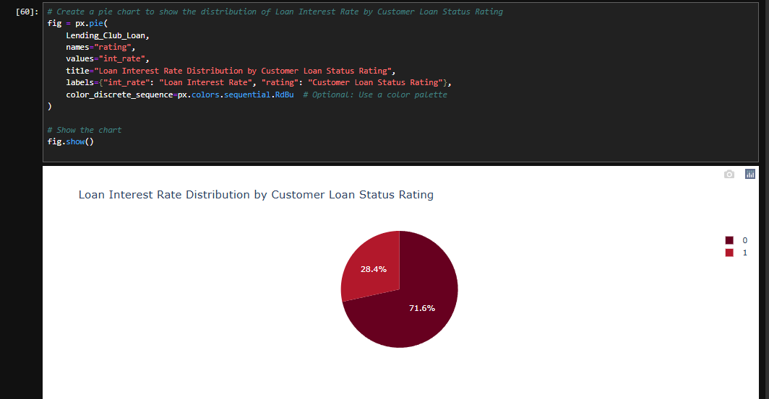

Slide 5
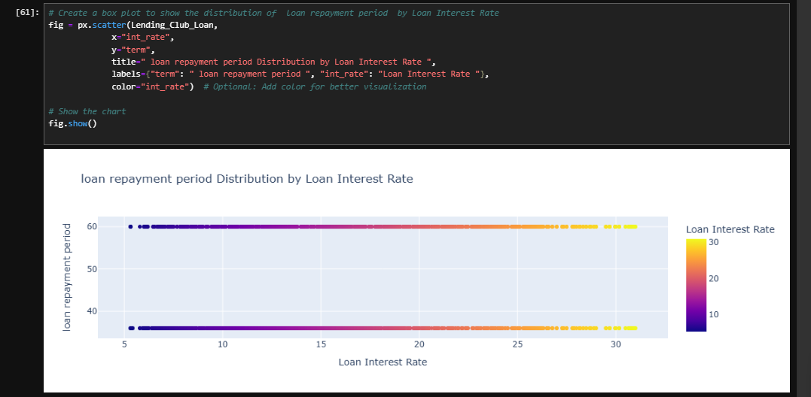

Slide 6
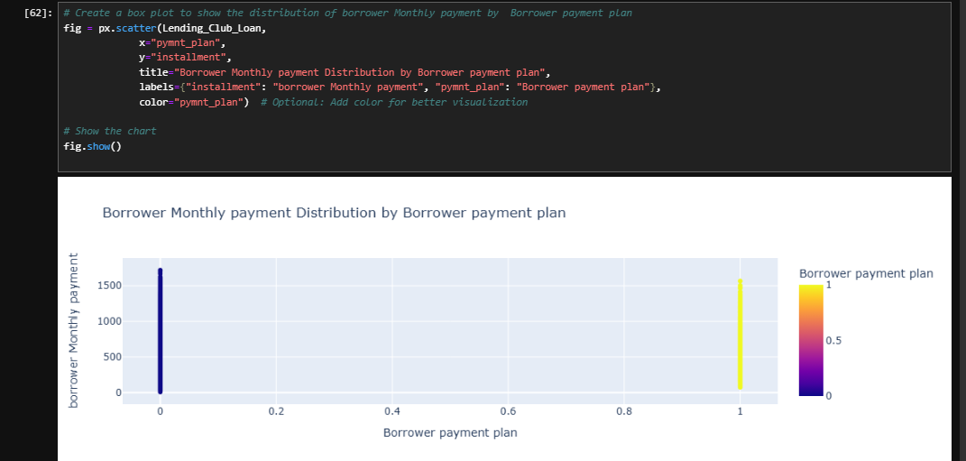

Slide 7
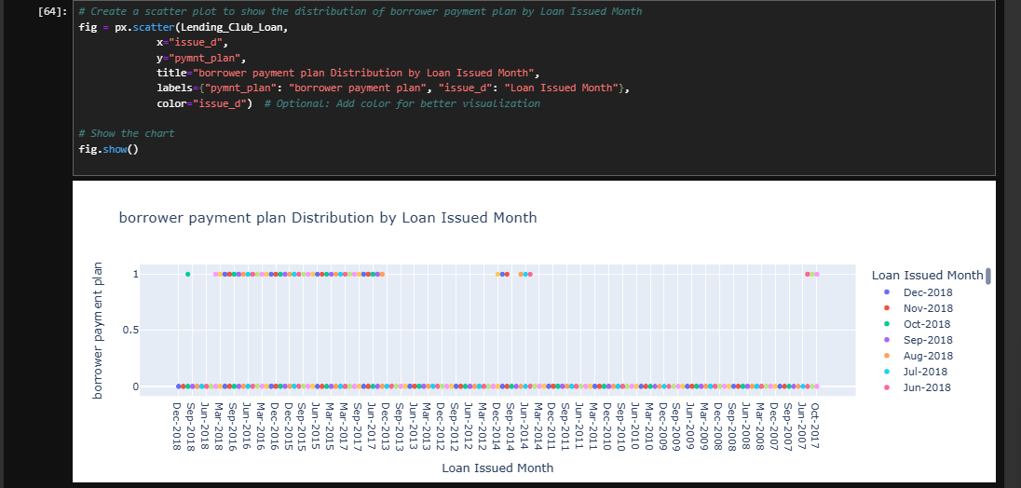
Loan Rating and Payment charts

Slide 8
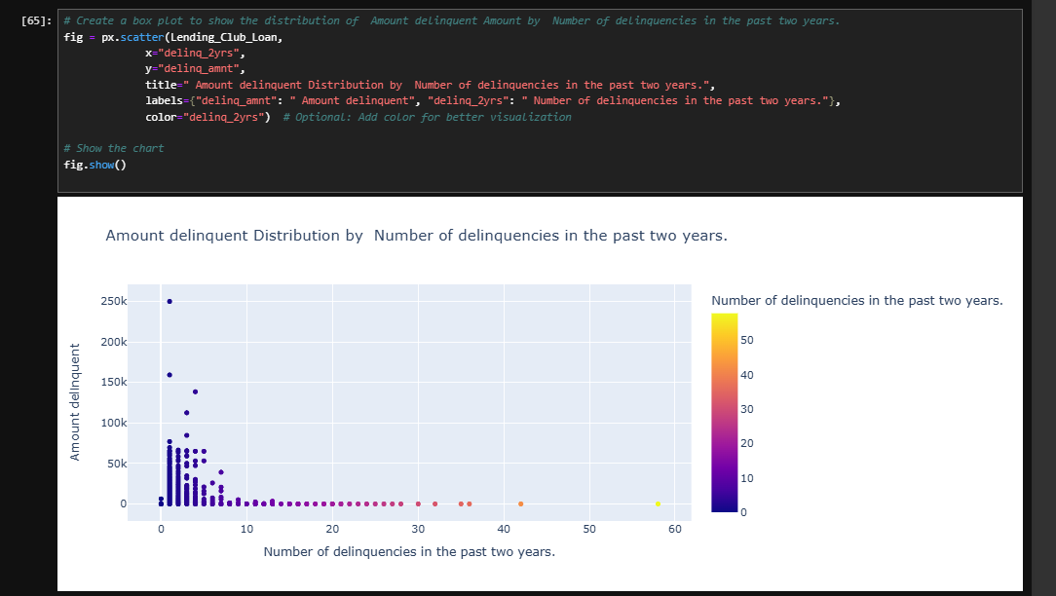

Slide 9
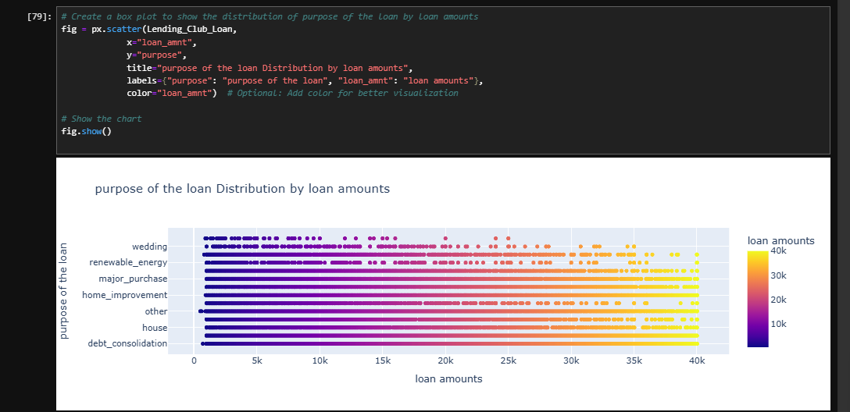

Slide 10
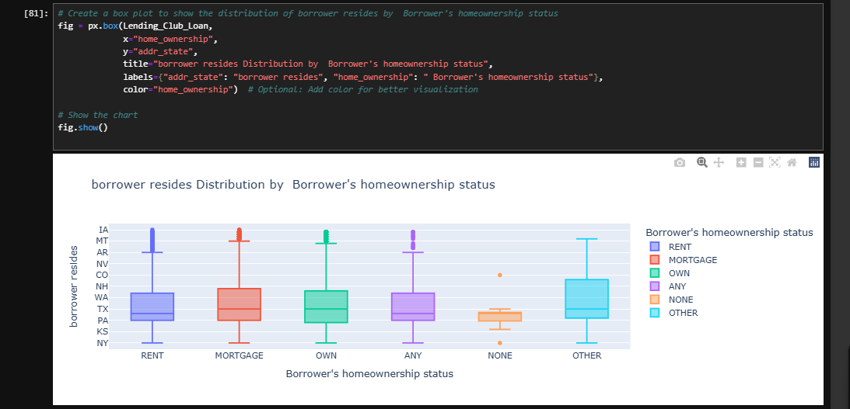

Slide 11
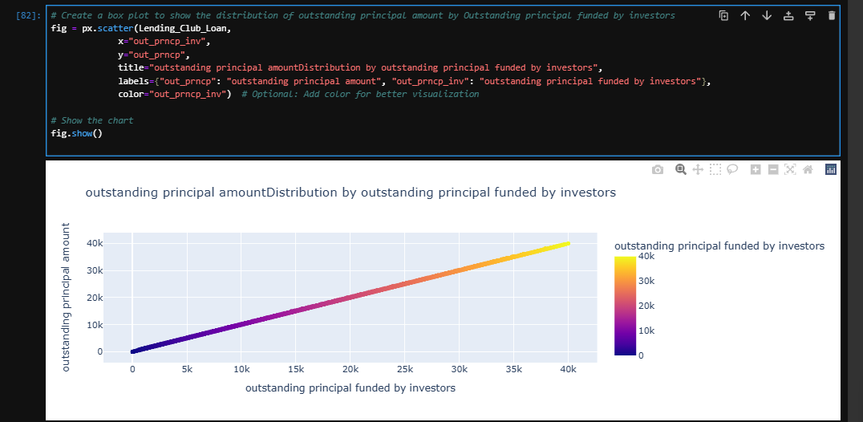

Slide 12
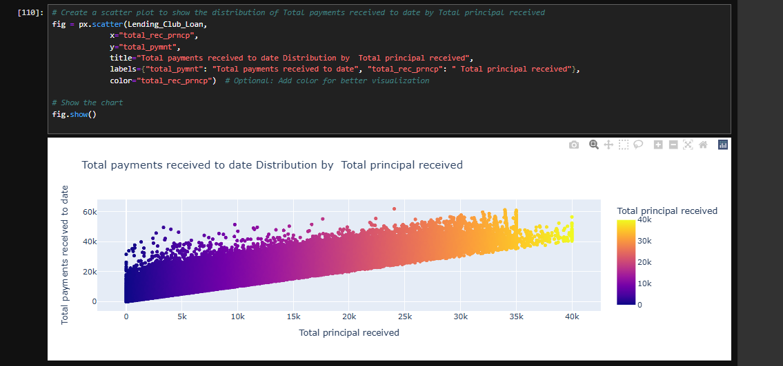

Slide 13
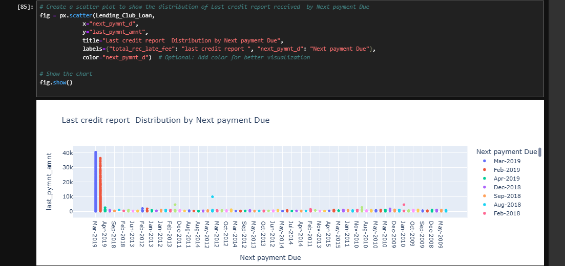

Slide 14
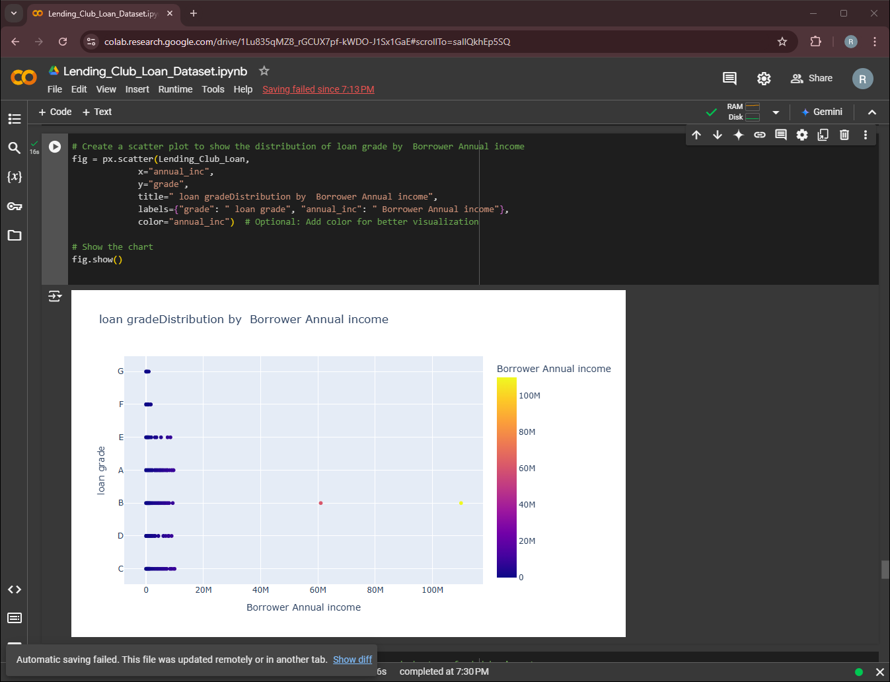
Borrower Information charts
The relationship between "Borrower Annual Income" and "Loan Grade," with colors indicating income levels. The plot highlights a concentration of lower-income borrowers and a few high-income outliers, with a syncing issue.

Slide 15
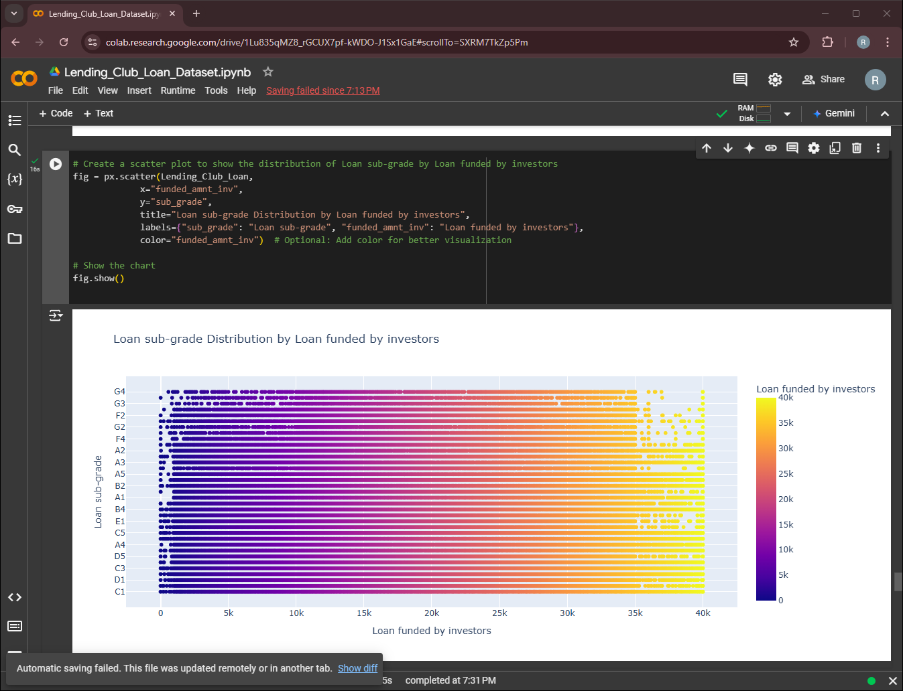

Slide 16
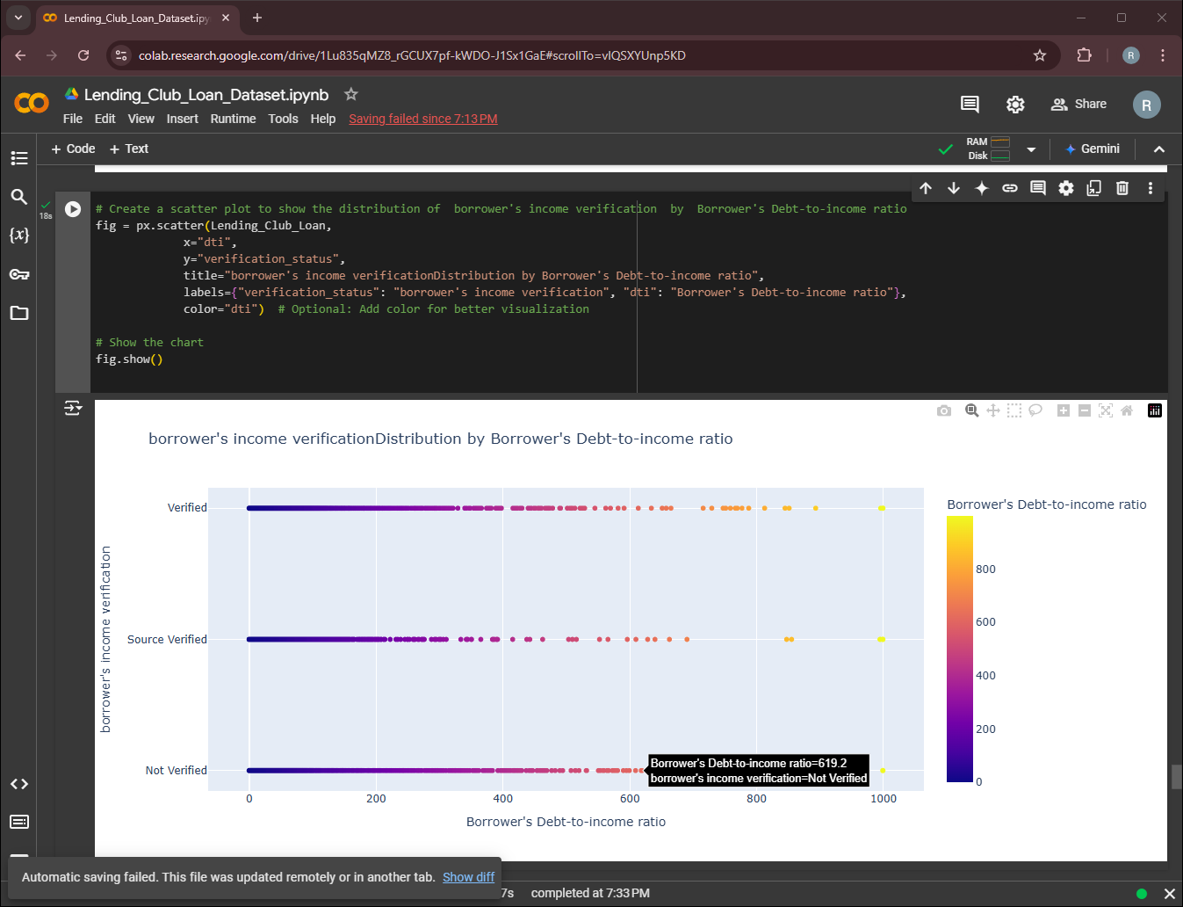

Slide 17
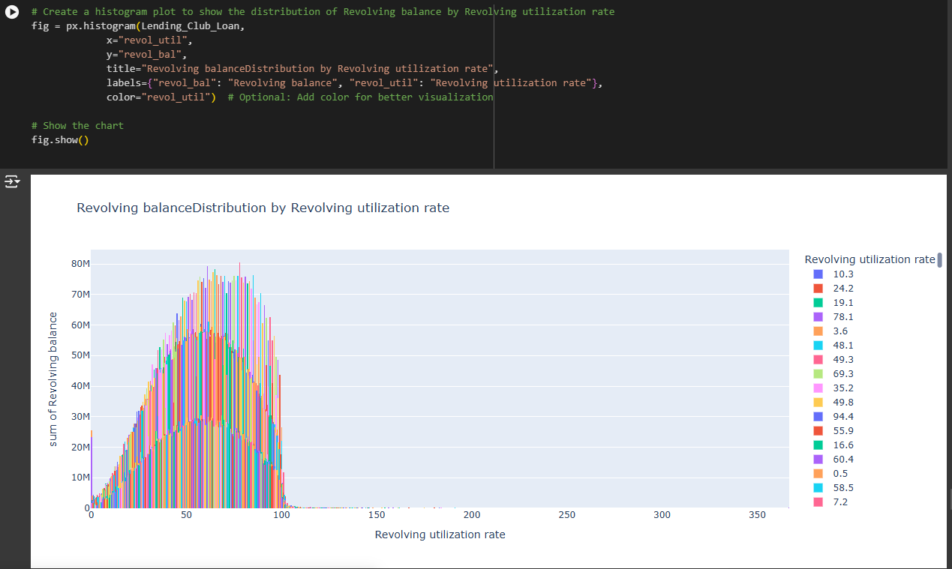
Borrower's income verification charts

Slide 18
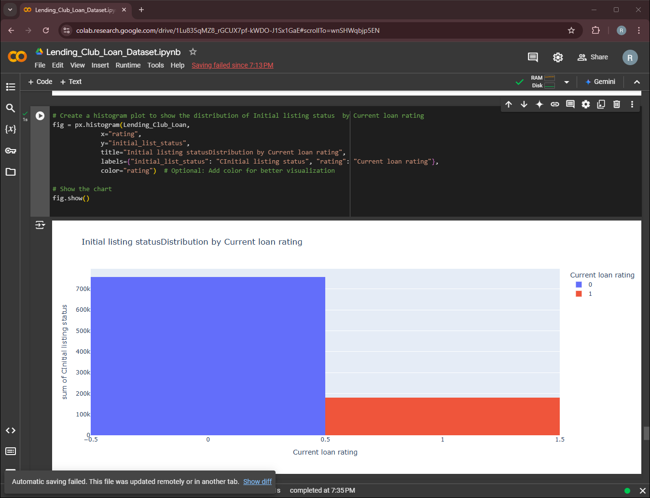

Slide 19
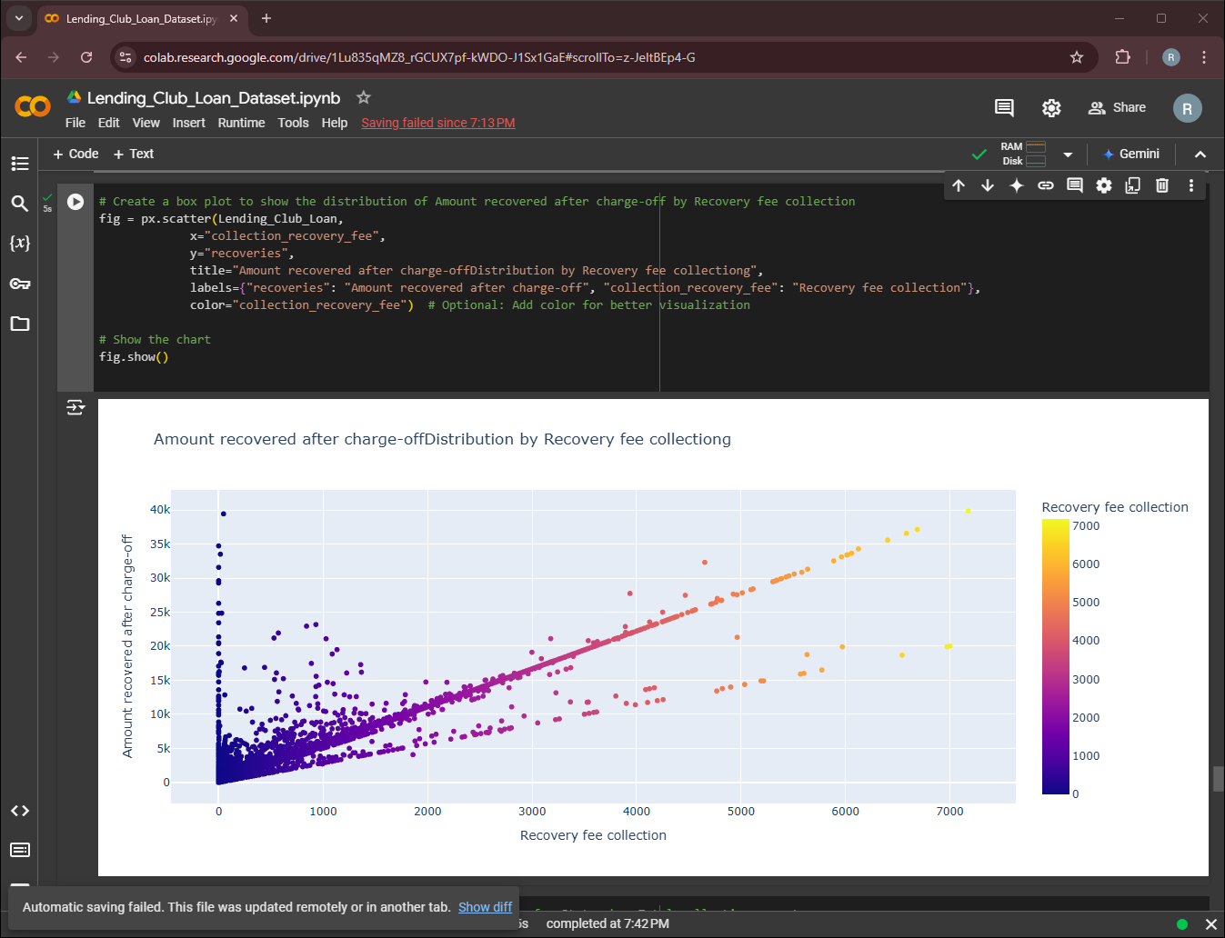

Slide 20
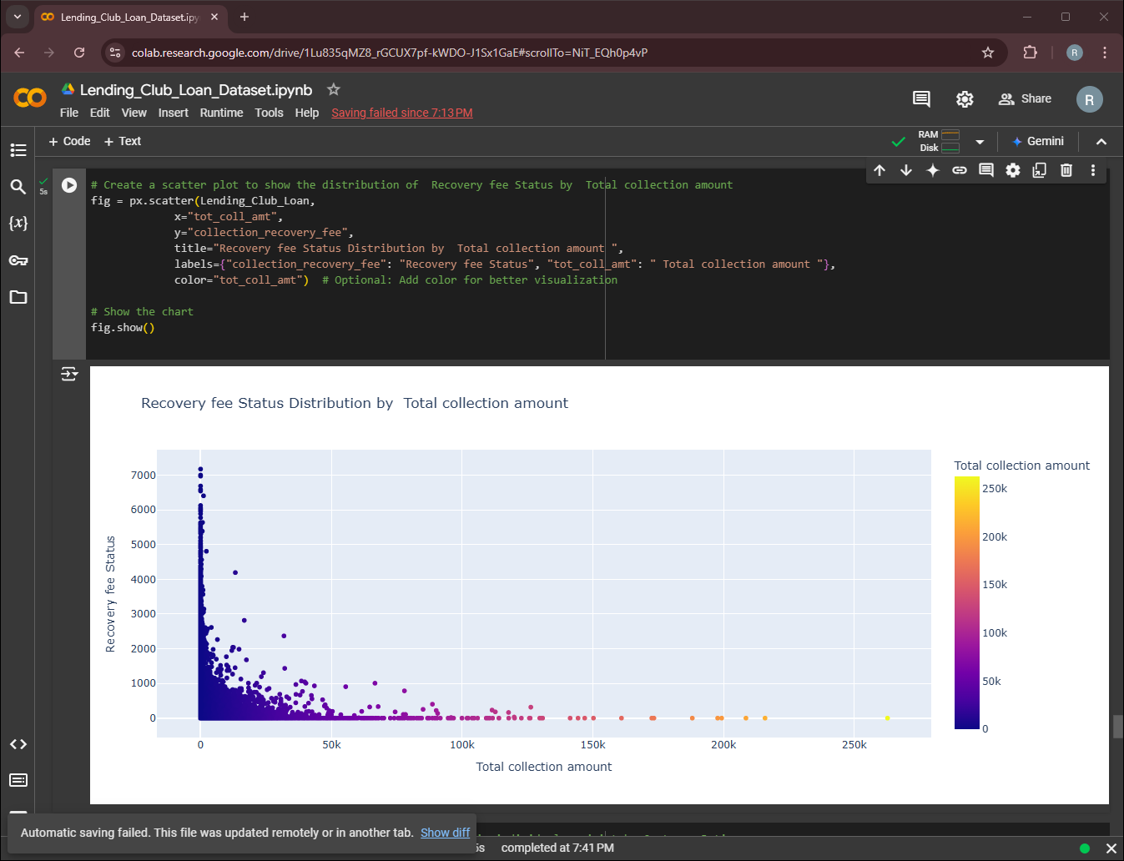

Slide 21
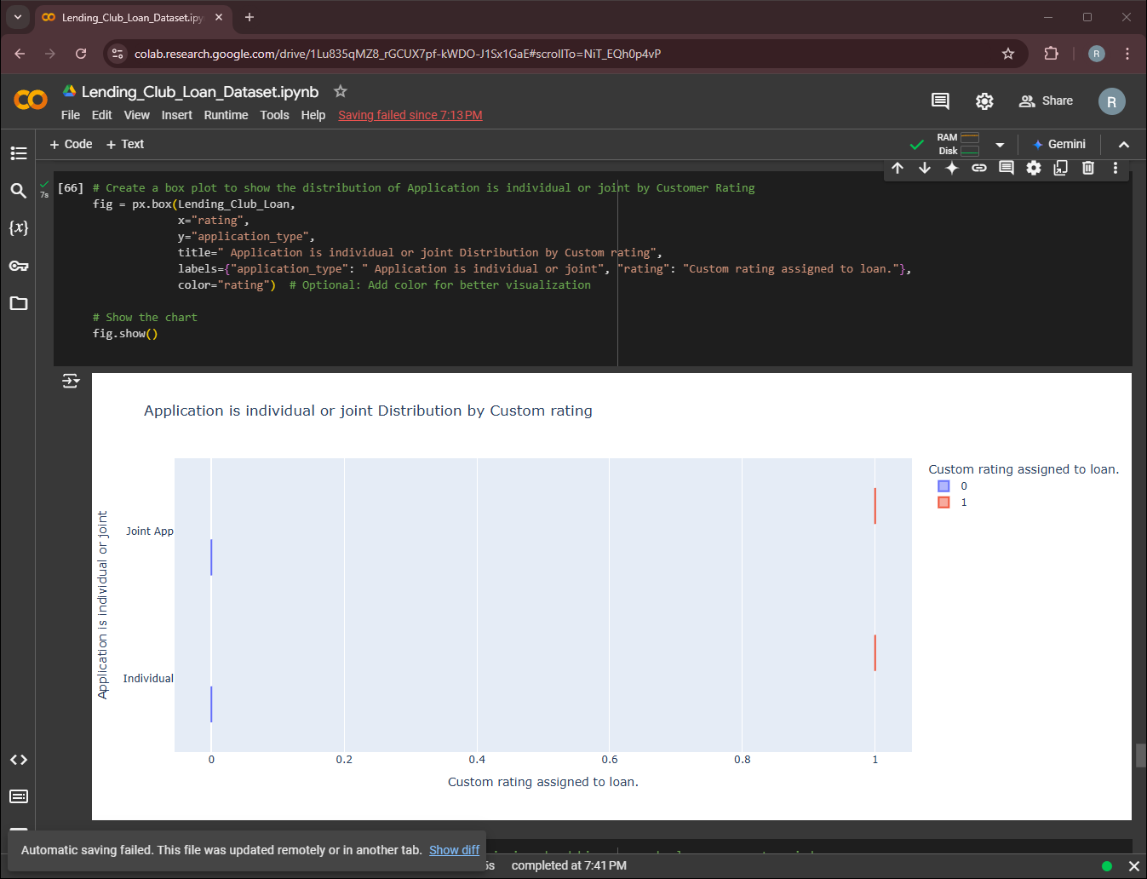

Slide 22
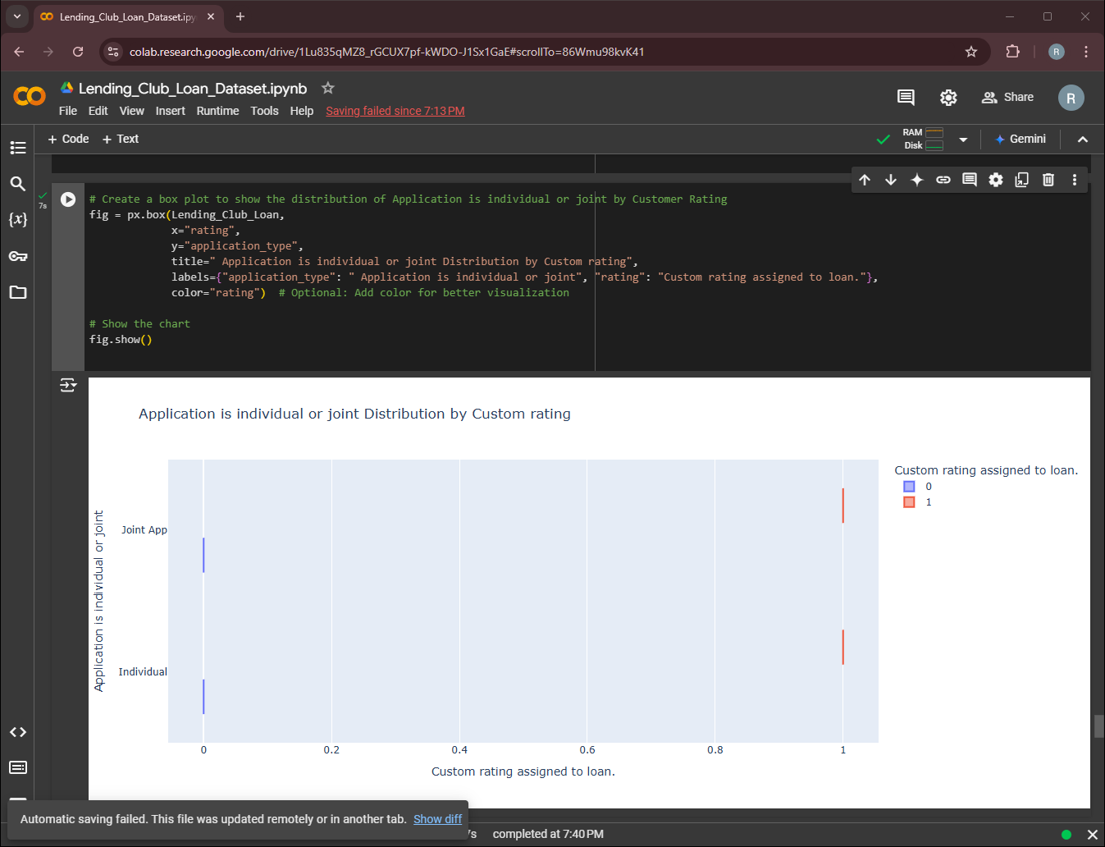

Slide 23
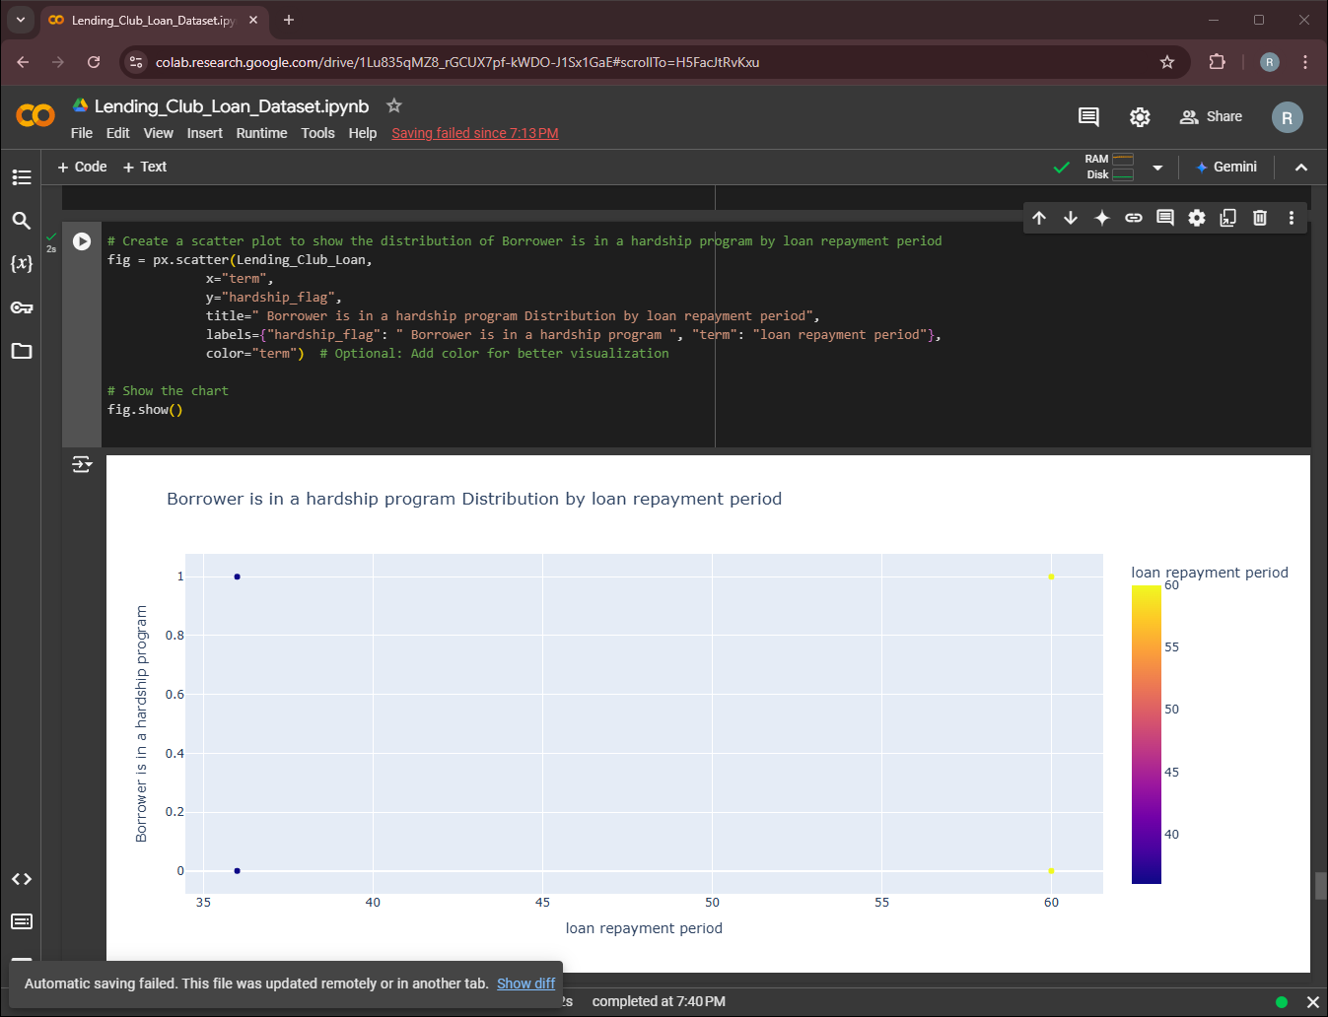

Slide 24
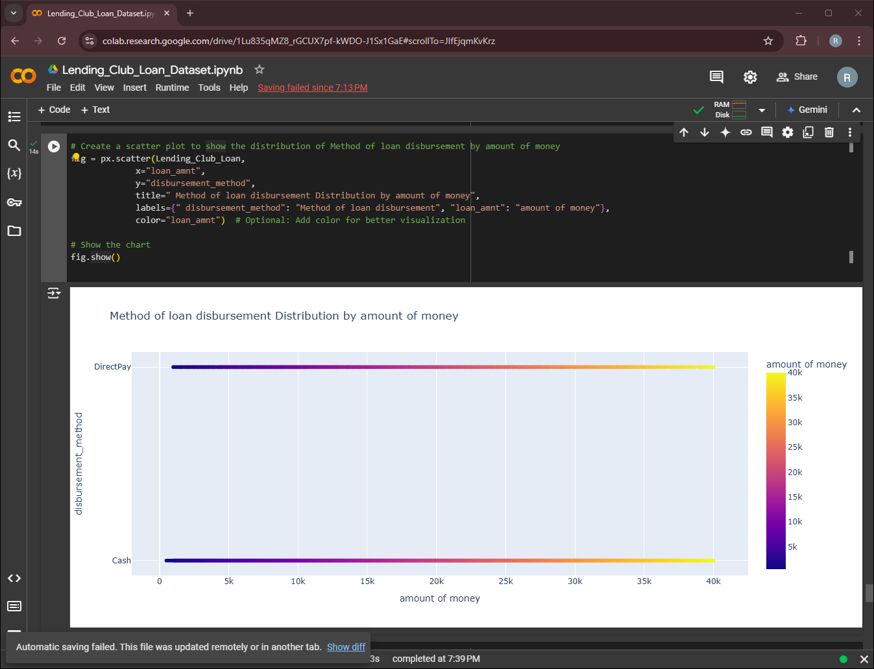

Slide 25
